Slide 1

Machine Programming
Identify Instruction Set Architecture
Know a
brief history
of x86 processors
Understand
the lifetime of
a program
Name
x86 integer registers
Command -> AS
Statement -> HLL
Instruction -> LLL
① Instruction Set Architectures
② Machine Programming

Slide 2


Machine vs. human language
Add 5 and 8
011000110101
instructions
words
instruction set
Tập lệnh
vocabulary
machine language
Hợp ngữ
assembly language
03 45 08
Add
Sub
Div
Mul
add 0x8(%ebp),%eax
Mnemonic :gợi nhớ
Inc, dec,

Slide 3

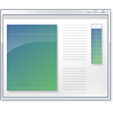
Lifetime of Program
#include <ioh>…
executable
Code time
Compile time
Run time
C/C++
ASM
Object
Compiler
Assembler
Linker
Trình biên dịch
Trình hợp dịch

Slide 4
Code Examples
Compiler
Assembler
C/C++
ASM
Object
Machine language -> ASM (reverse)
Disassembler
gcc –Og –c example.c
objdump –d example.o
gcc –Og –S example.c
Notes:
gcc –Og –S example.c

Slide 5
Program Performance
Program
Compiler
Hardware
C:
Easy
Portable
Architecture
ASM:
Difficult
Non-portable
CHAP

Slide 6
① System’s state
③
② Instructions
CPU can execute
Instruction
Set
Architecture
Architecture
Notes:
Instructions: có gì, làm gì, encode ntn
Registers: có bao nhiêu, wide?
Memory: xác định vị trí trong bộ nhớ

Slide 7









Instruction Set Architectures
x86
MIPS
PowerPC

Slide 8
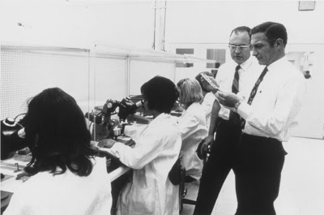
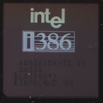
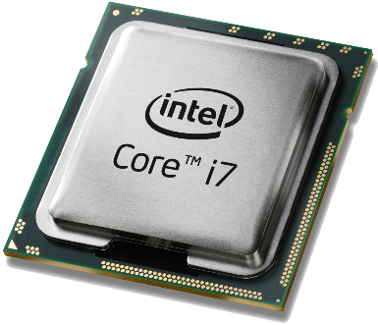
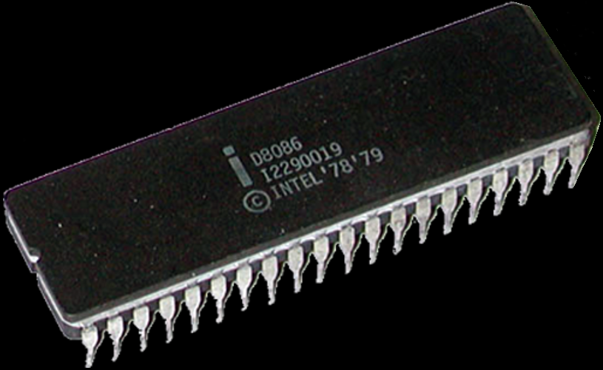
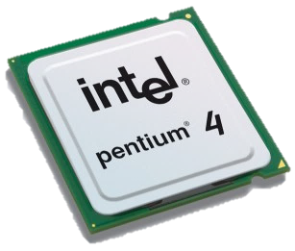
Intel
PSU we choose Intel
1968
1985
2016
1978
2005
Transistor
count
29K
275K
250M
7.2B
Notes:
# Transistors

Slide 9


The number of
transistors in
a chip will
approximately
double every 2 years
Gordon Moore
Notes:
Someinterestingfactsaboutwhatthesevarious-sizedbytescanstore:1bit:abinarydecision1byte:acharacter5Megabytes:ThecompleteworksofShakespeare2Gigabytes:20metersofshelvedbooks10Terabytes:TheprintedcollectionoftheUSLibraryofCongress200Petabytes:Allprintedmaterialinthewholeword.5Exabytes:Allwordseverspokenbyhumanbeings
Themostcommonlyacceptedexplanationisthatourbase-10numbersystemwasadoptedbyourancestorsmostlikelybecausewehave10fingers.Interestinglyenough,maybethatiswhydigitinEnglishalsomeansafingerortoe.

Slide 10

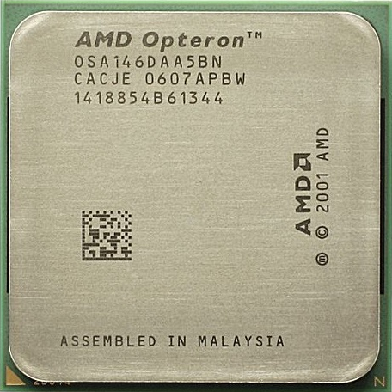
Advanced Micro Devices

Slide 11

Programmer’s View
Memory
General & Special
Object
Code
Program
Data
OS Data
Address
Registers
Data
Condition Codes
Instructions
Program Counter
Stack
CPU

Slide 12
Compiling
1 statement in C -> many instructions in assembly
32-bit
int sum(int x, int y)
{
int t = x+y;
return t;
}
sum:
push %ebp
mov %esp,%ebp
mov 12(%ebp),%eax
add 8(%ebp),%eax
mov %ebp,%esp
pop %ebp
ret
code.c
gcc –O1 –S code.c
More complicate but shorter
sum:
leal (%rdi,%rsi),%eax
ret
64-bit
Notes:
code.c

Slide 13
Categories of Registers
Data
Address
Floating point
Instruction
Conditional
Constant (zero, one, or pi)
Vector
Special-purpose
General purpose registers (GPRS)
1/ Register (how many?)
What, where, function?

Slide 14
IA32 Integer Registers
%ax
accumulate
base
Store base address
%bx
%cx
counter
Repeat 50 times…
%dx
data
%si
source index
%di
destination index
%sp
stack pointer
%bp
base pointer
x86-64 Integer Registers

Slide 15
IA32 Integer Registers
%rax
accumulate
%eax
%r8
%ax
%r8d
%rbx
base
%ebx
%r9
%bx
%r9d
%rcx
counter
%ecx
%r10
%cx
%r10d
%rdx
%r11
%edx
data
%r11d
%dx
%rsi
source index
%esi
%r12
%si
%r12d
%rdi
destination index
%edi
%r13
%di
%r13d
%rsp
stack pointer
%esp
%r14
%sp
%r14d
%rbp
base pointer
%ebp
%r15
%bp
%r15d
x86-64 Integer Registers

Slide 16
Sub-register
rax
al
ax
eax
Same for rbx, rcx, rdx
Notes:
Same for rbx, rcx, rdx, rsi, rdi, rbp, rsp

Slide 17
Sub-register
rsi
sil
si
esi
Same for rdi, rbp, rsp
Notes:
Same for rbx, rcx, rdx, rsi, rdi, rbp, rsp

Slide 18
Sub-register
r8
r8b
r8w
r8d
Same for r9, r10, r11, r12, r13, r14, r15
Notes:
eax

Slide 19
Summary
Instruction Set Architecture
Program Performance
Intel x86 Architecture
x86 Registers

